Slide 1

Chapter 7

Slide 2
Chapter 7 Outline
Anatomy of a Modern Information System
Architectural Concepts
Interoperability
Architectural Diagrams
Describing the Environment
Designing Application Components

Slide 3
Anatomy of a Modern System – Computing Devices
Server – manages shared resources and enables users and other computers access to these resources
Personal computing devices or clients
Desktops, laptops, tablets, smartphones…

Slide 4
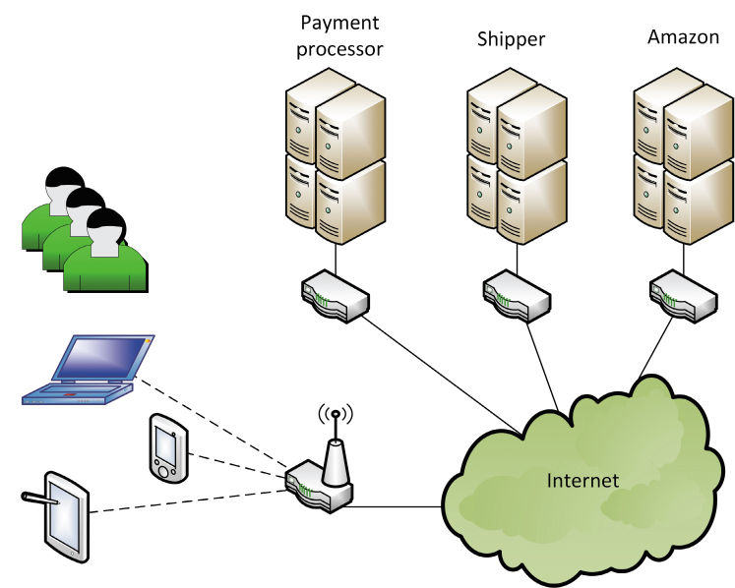
Simplified architecture for application (Amazon.com)

Slide 5

Server Farm –
Very large databases and very high use

Slide 6
Anatomy - Networks
Computer network – hardware, software, transmission media
Internet backbone –
High-capacity with high-bandwidth trunk lines and large high-speed computers
Owned by governments and telecom companies
Local area network (LAN) –
Small network for a single site
World Wide Web (WWW)
All the interconnected resources accessed through the Internet

Slide 7
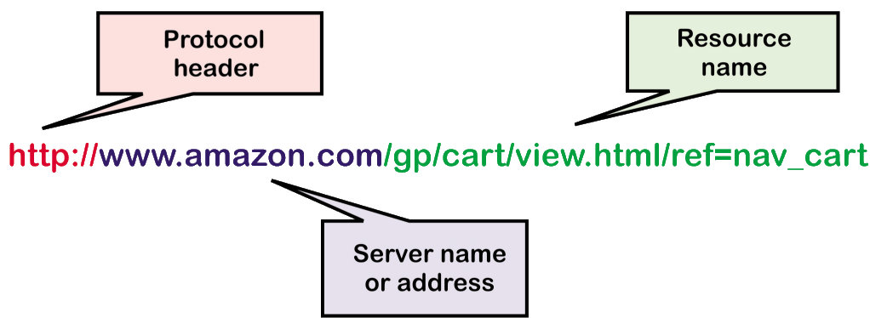
Anatomy - Networks
Uniform Resource Locator (URL)
The identifier for the Web to locate a particular resource
Hyperlink –
The URL of a resource embedded within another resource

Slide 8
Anatomy - Software
Application software – programs that perform work for users
Either a custom app or a Web-based application
App –
A custom program usually for a laptop or smartphone
System Software –
Behind the scene software, works as glue to hold everything together

Slide 9
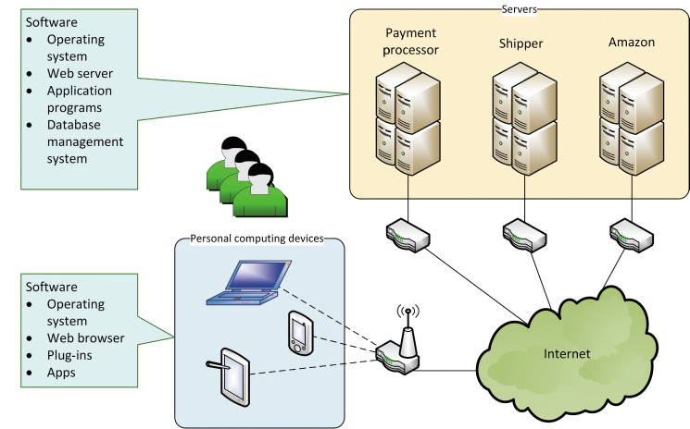
Anatomy – Software

Slide 10
Anatomy – Software
Web-Based Applications
Uses a web browser
Accessed through a URL
Resides on a Web server
Uses standard IP protocols
Embedded Software
Software apps or functions embedded within another app, such as within a browser or O/S
Toolbars, Plug-ins, Widgets

Slide 11
Anatomy – Protocols
Protocol
A set of languages and rules to ensure communication and data exchange between hardware and software
Network protocols
Virtual Private Network (VPN)
Creates a private network but on the Internet by using secure technologies and encryption

Slide 12
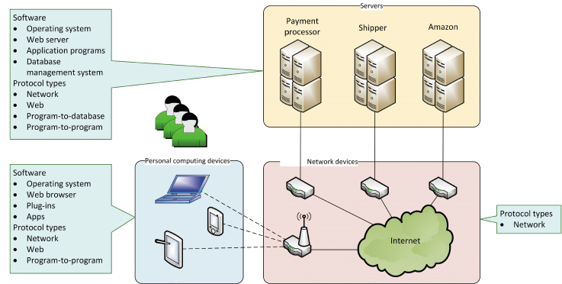
Anatomy – Software and Protocols

Slide 13
Anatomy – Web Protocols
HTML (hypertext markup language)
Protocol for the structure and content of a Web page
XML (extensible markup language)
An extensions of HTML that enables defining semantics of tags
HTTP (hypertext transfer protocol)
Defines format and content for transfer of Web documents
HTTPS (hypertext transfer protocol secure)
Encrypted and secure http transfers

Slide 14
Architectural Concepts
Technology architecture
Computers, network computers and hardware, and system software
Application architecture
The software programs and their configuration

Slide 15
Software as a Service (SaaS)
SaaS
No software is installed on the user’s device
Application services is accessed remotely
User data is isolated and stored on common servers

Slide 16
Web Services
Web service
Software function that is executed with Web standards
Access via a URL
Inputs sent via the URL
Executes remotely
Data returned within a Web page

Slide 17
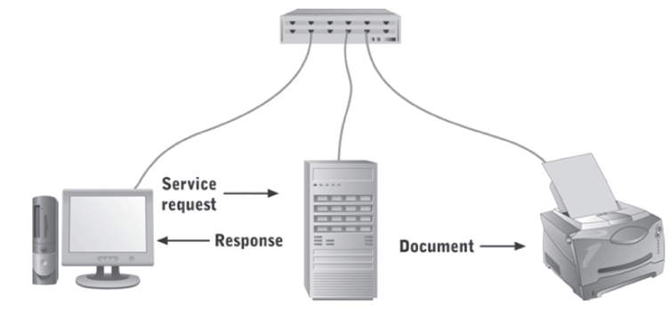
Distributed Architectures
Client/Server architecture
Software design with part of the application on a server and part on the client

Slide 18
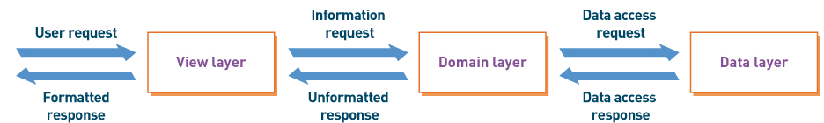
Distributed Architecture
Three-Layer architecture
Client/server architecture with application divided into view layer, logic layer, and data layer
View layer – the user interface
logic layer – program logic to implement the functions
data layer – the functions to access the data

Slide 19
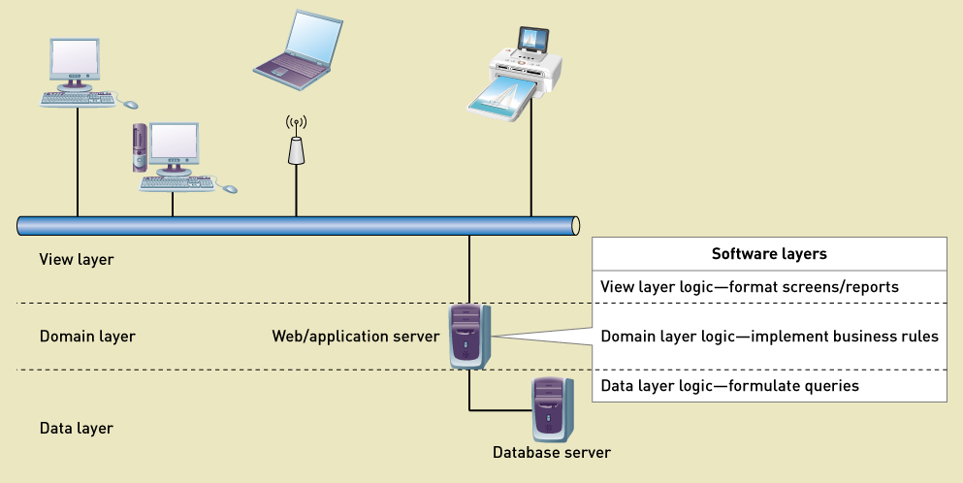
Three Layer Architecture

Slide 20
Interoperability
Interoperability
The ability of an application to interact with other software
Important characteristic in current development projects
Understand the environment
Reuse software existing components (purchased or in-house)
Build components considering interoperability
Combine all components into a solution system

Slide 21
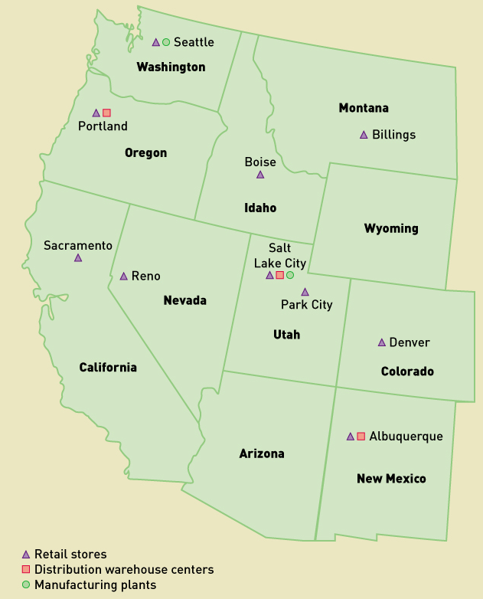
Diagrams for System Architectures
Location Diagrams
Identify geographical placement of hardware, software, and users

Slide 22
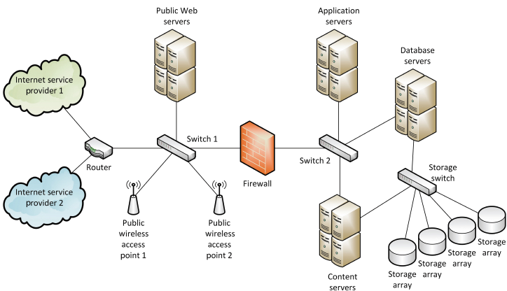
Diagrams for System Architecture
Network Diagrams
How the application software is deployed across the hardware and system software

Slide 23
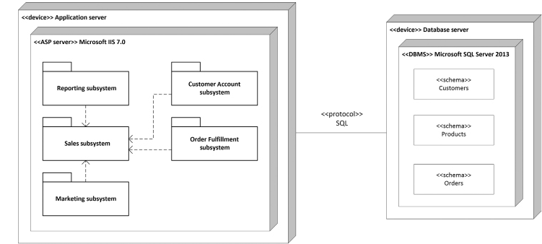
Diagrams for System Architecture
Deployment Diagrams
How the components of a network are interconnected

Slide 24
Describing the Environment
Key Questions to help describe accurately
What are the key features of existing or new environment
O/S, system software, networks, tools
What are the external systems or DBMSs
What kind of interaction
What is the data
What are the protocols
What kind of security

Slide 25
Describing the Environment
Key Questions to help describe accurately
What devices will be required
Protocols for devices
Security
What APIs
What user-interface technology will be used
Where and who are users, and what skills
What hardware and devices
What client O/S will be used
Security requirements
What APIs are needed

Slide 26
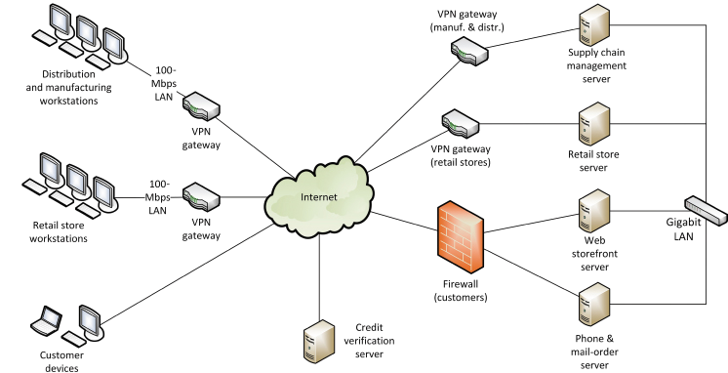
RMO Environment - Existing
Current environment prior to new development

Slide 27
RMO Environment - Proposed
More mobile devices and apps
Web application software and content
Social networking applications
Security issues
External hosting of portions

Slide 28
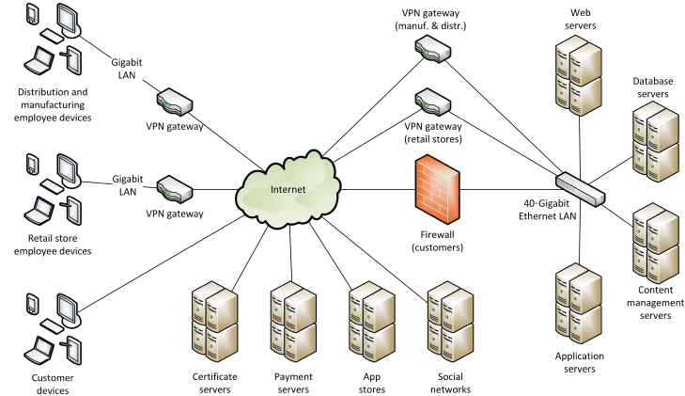
RMO Environment - Proposed

Slide 29
Designing Application Components
Application Component Boundaries
Which components perform which functions
How to group functions to build components
Actors – what functions to particular actors use
Shared data – what functions use the same data
Events – what functions occur in common business events

Slide 30
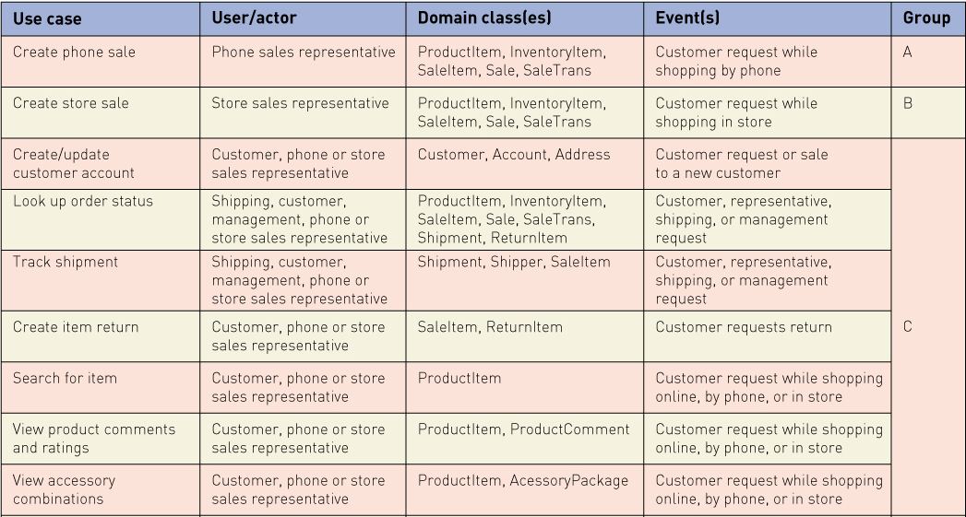
RMO CSMS Application Architecture
Grouping by customer actor – part 1

Slide 31
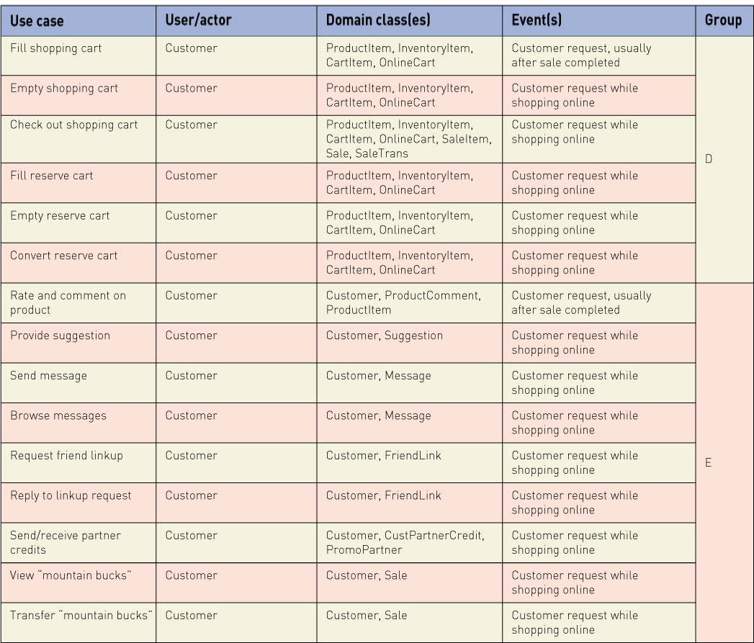
RMO CSMS Application Architecture
Grouping by customer actor – part 2

Slide 32
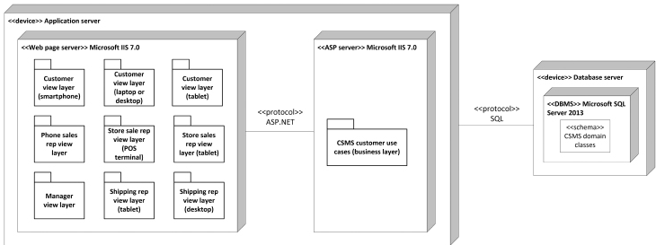
RMO CSMS Deployment Diagram
Three-layer design with user components grouped by user functions

Slide 33
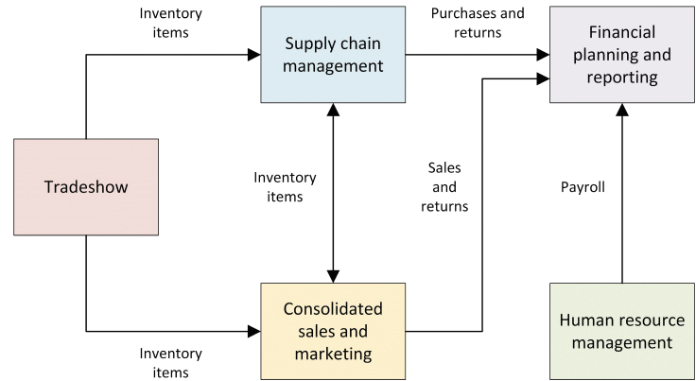
RMO CSMS Component Integration
Subsystem integration and data flows

Slide 34
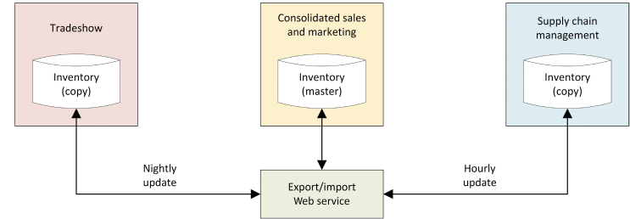
RMO CSMS Data Ownership
Who “owns” the data
System of record
What system is responsible to maintain the data
What system has a copy or can access the data

